Slide 1
PMS 2.5
PDF Merge and Split _{(Ver 2.5)}
Designed and Developed
By
Vivek K (Inst)

Slide 2
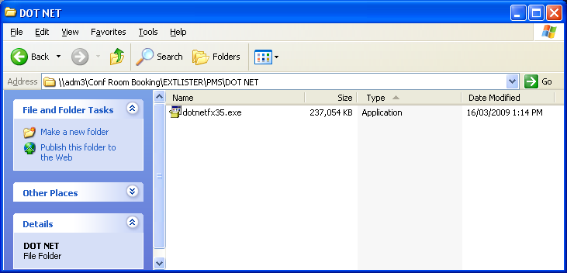
How to Install ?
Step 1:
PREREQUISITE
.NET framework 3.5 or higher
You Can find the setup for .NET Framework 3.5 in the following path.
\\adm3\Conf Room Booking\EXTLISTER\PMS\DOT NET
However you can get this from IT Dept also
Anyway Admin Rights are required to install this .NET framework. So please request IT-Dept for installing this suite.
In some PC this might have been installed already.

Slide 3
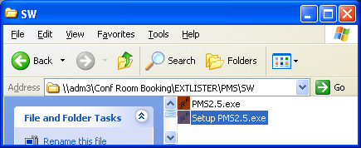
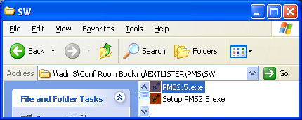
Step 2:
There are two Options for using this PMS
\\adm3\Conf Room Booking\EXTLISTER\PMS\SW
With Installer (Setup)
    -> Faster (Recommended)
Without Installer
-> Each Time It Will Take Significant Amount Of Time To Initiate

Slide 4
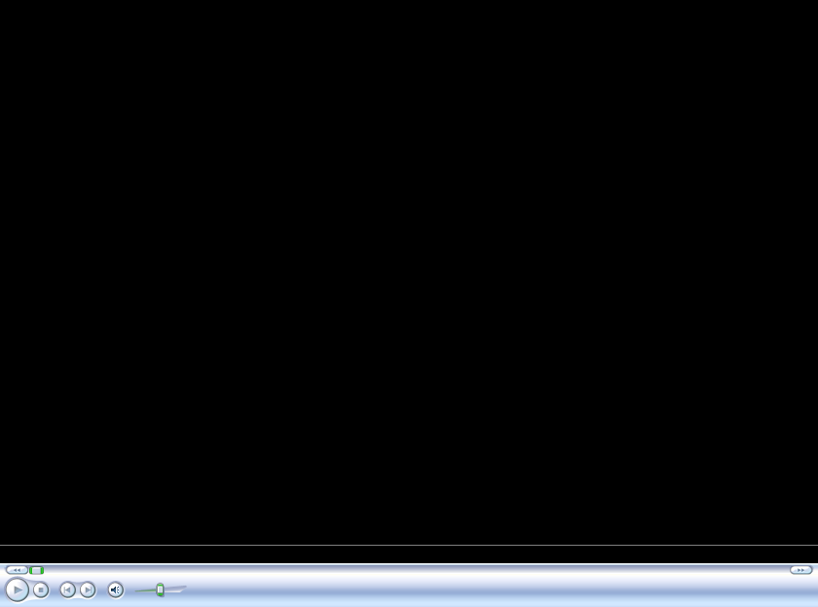
Please copy and paste the files in your local machine before using the software

Slide 5
MERGE & SPLIT
How To Input The PDF Files In PMS
( It Won’t accept Protected (encrypted) PDF Files )

Slide 6
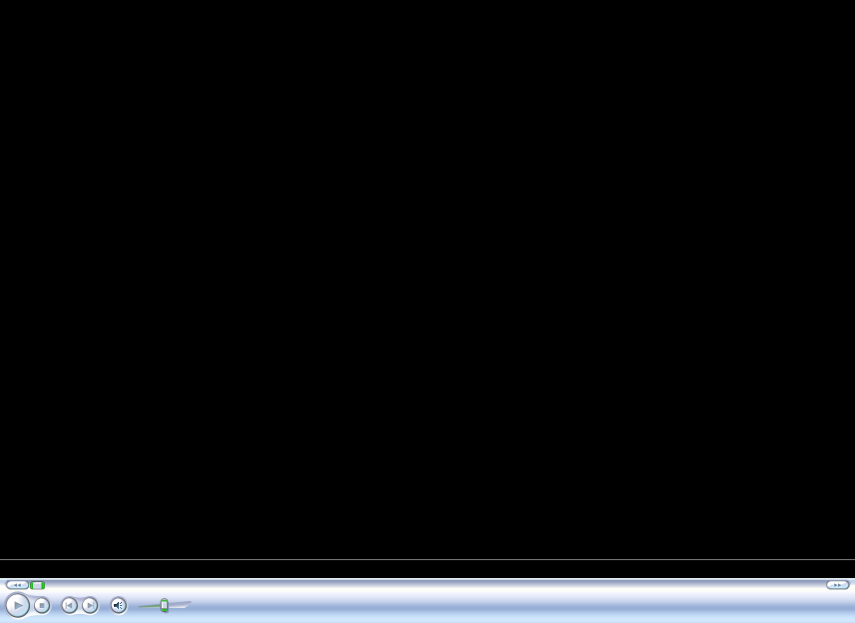
Merging of PDF Docs

Slide 7
Splitting of PDF Docs

Slide 8
Inserting the Pages

Slide 9
PAGE NUMBERING

Slide 10
DRAWBACKS
Merge & Split
PMS will not retain PDF documents Bookmarks
Size of the PDF files won’t be optimized
Page Numbering
We can not update the Page Number
(Take the backup Before Applying the page number)
Note :
  If you come across bugs while using please report to author
  Make sure that output is proper

Slide 11
DROP YOUR SUGGESTIONS HERE


Slide 12

Thank You !

